Slide 1
WarFront
Matt Newbill
Matt Hamersky
Max Sadovskiy

Slide 2
Engine
Passive to Active rendering
SurfaceView
Custom Widgets
Object Creation
Pooling
FSM

Slide 3
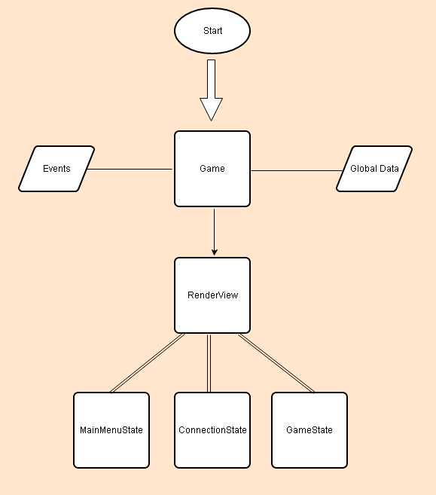

Slide 4
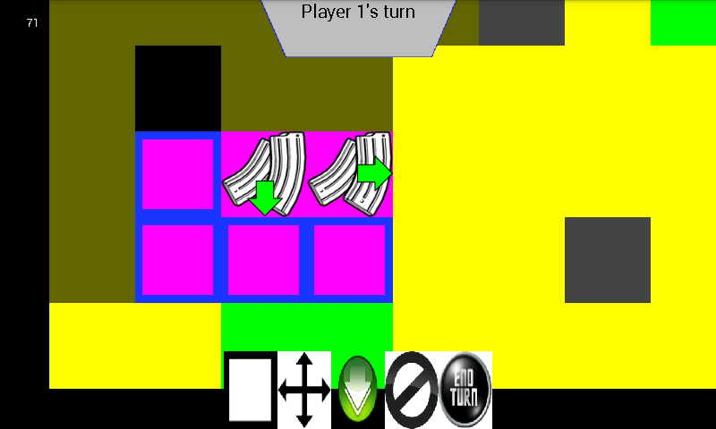

Slide 5
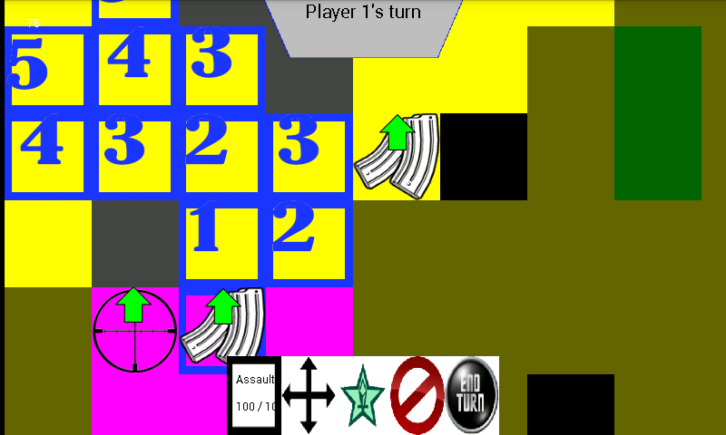

Slide 6
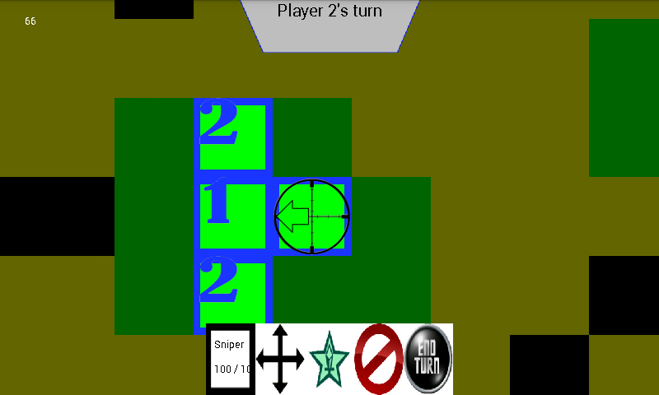

Slide 7
